Slide 1
Prediction Accuracy vs. Model Interpretability
Why not just use a more flexible method?
There are two reasons
Reason 1:
Linear regression is much easier to interpret (the Inference part is better). For example, in a linear model, β_{j} is the average increase in Y for a one unit increase in X_{j} holding all other variables constant.
Notes:
It seems machine-learning models are flexible and accurate. (CLICK)Then the question is why not use such flexible models all the time. (CLICK) There are two reasons why simple models are still preferred in some situations.
(CLICK) A simple method such as linear regression produces models that are easier to interpret. Making Inferences with linear regression is much easier. For example, Betas in linear regression are the average increase in Y for one unit increase in X variables when we hold all other X variables constant. This is such a straight forward interpretation which is lacking in machine-learning.

Slide 2
Prediction Accuracy vs. Model Interpretability
Reason 2:
It is often possible to get more accurate predictions with a simple, instead of a complicated, model because it is harder to fit a more flexible model.
Notes:
Here is Reason number two. Let us assume we do not care about inference. (CLICK) Even when you are only interested in prediction, it is possible to get more accurate predictions with a simple model. This seems counter intuitive but it has to do with the fact that it is harder to fit a more flexible model. We need a lot more data, there is the danger of overfitting, etc. For these reasons, we might end up with poor predictions with flexible models.

Slide 3
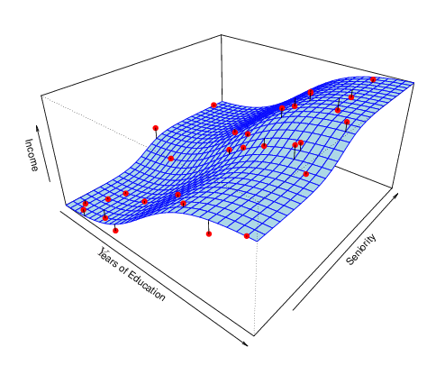
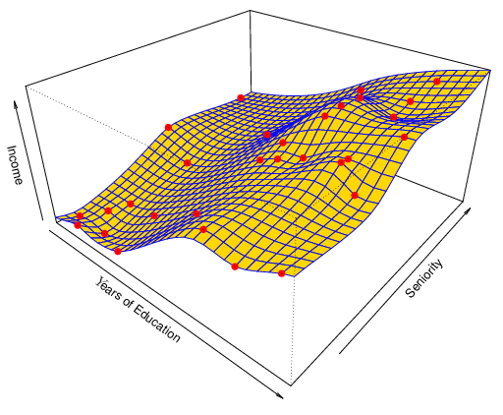
Prediction Accuracy vs. Model Interpretability
Non-linear regression methods can also be too flexible and produce poor estimates for f.
Notes:
Like I just mentioned, with flexible models we always have the danger of overfitting. (CLICK) In this figure, we see that the fitted model touches every data point. This is clearly an example of overfitting. (CLICK) It is unlikely this model fits the true function well. It will not perform well in a new data set. (CLICK) We are better off with a model like this which is flexible but not too flexible. This model will be more likely to perform better in a new data. In sum, machine-learning is not the best choice all the time. We have to be careful while fitting machine-learning models.

